Slide 1

Outcomes of the research– Honeycomb of participation in national level youth organizations
Training Course C1
Poznan, Poland

Slide 2
What did we try to look at
How democratic are the youth organizations?
Is there a clear system for participation and involvement of young members?
What does it depend on?
So that we can build appropriate training and support to improve the youth participation

Slide 3
Hypothesis of the research
Existence of clear internal procedures and documents is a pre-condition for functioning democratic management in youth organizations
Organizations decision-making takes care that the diversity of members is well represented
The members of the organizations are consulted on every issue related to the organizational decision-making.

Slide 4
Who responded and how?
The questionnaire was sent by the project partners to respondents in Poland, Turkey and Macedonia.
It was answered online by 140 organizations with fairly equal balance between the countries

Slide 5
Some demographics of the responses

Slide 6
Who is usually running the democracy in youth organizations
2 in 3 youth organizations have up to two staff members.
Only 1 in 3 youth organizations has more than 50 members
Usually youth organizations are small groups of youngsters, self-organized and completing the work on a voluntary basis

Slide 7
Inside the organizations

Slide 8
Who is responsible to make a decision?

Slide 9
Engaging members

Slide 10
Does it depend from location

Slide 11
If democracy is engaging members in decision-making here is how it varies according to location

Slide 12
… and here is how it varies according to number of members

Slide 13
… and according to having or not having staff members

Slide 14
When do we meet members of associations

Slide 15
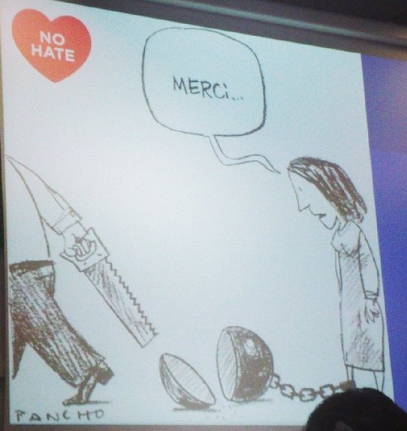
Thank you for your attention

